Slide 1
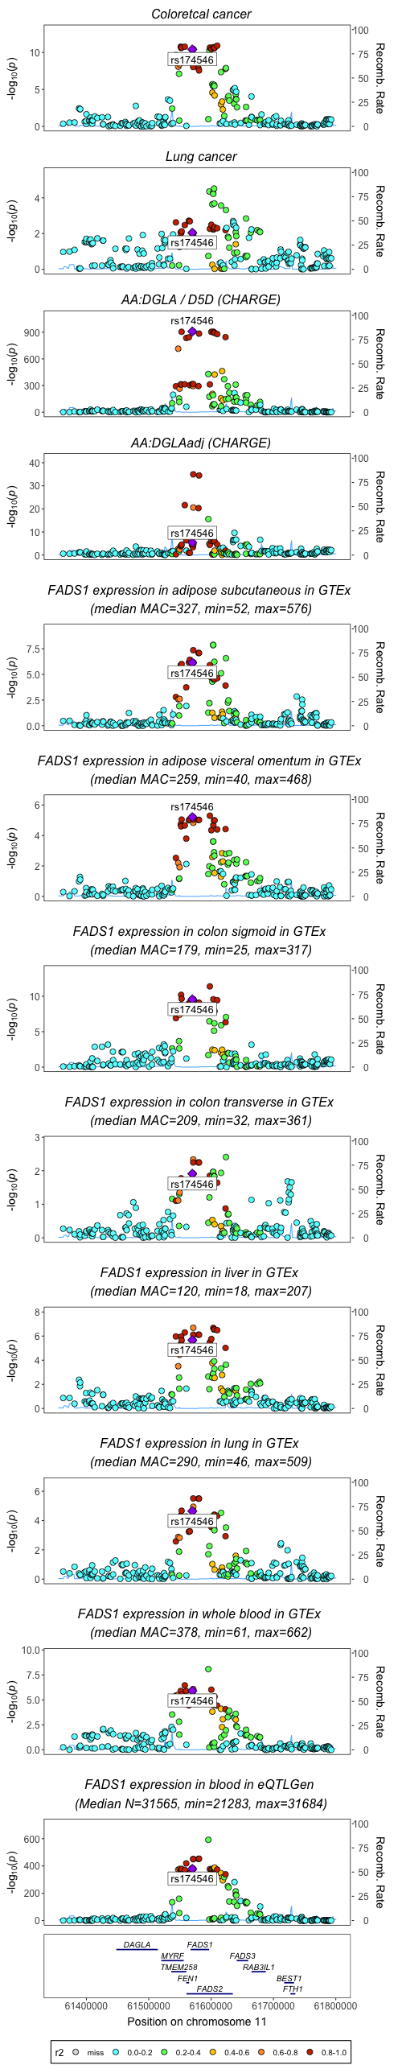
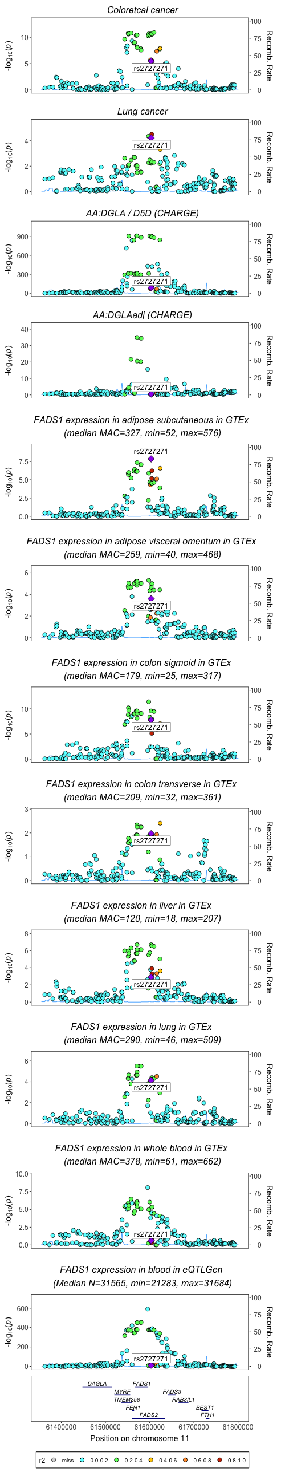
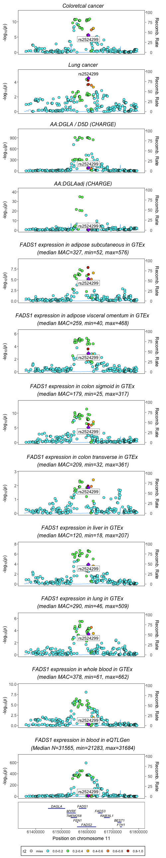
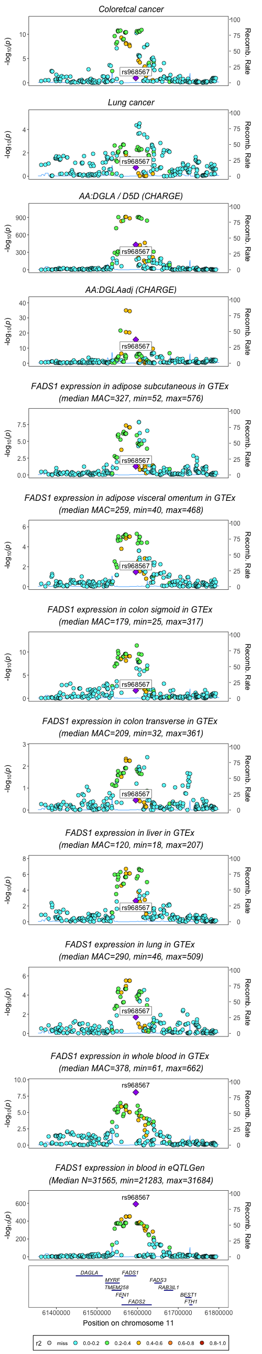
Position of rs174546, rs2524299 and rs968567 in associations for FADS1 activity/expression and cancer (non imputed data for fatty acids from CHARGE)
R2=0.929 rs2524299 and rs2727271

Slide 2
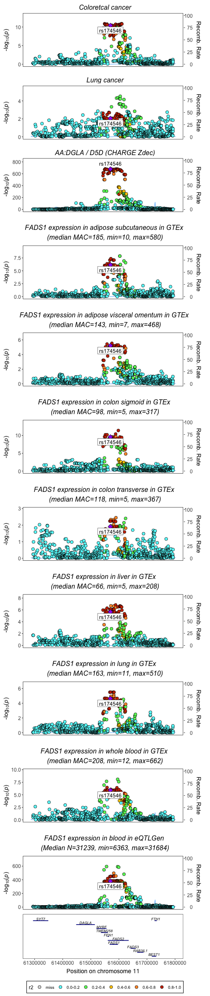
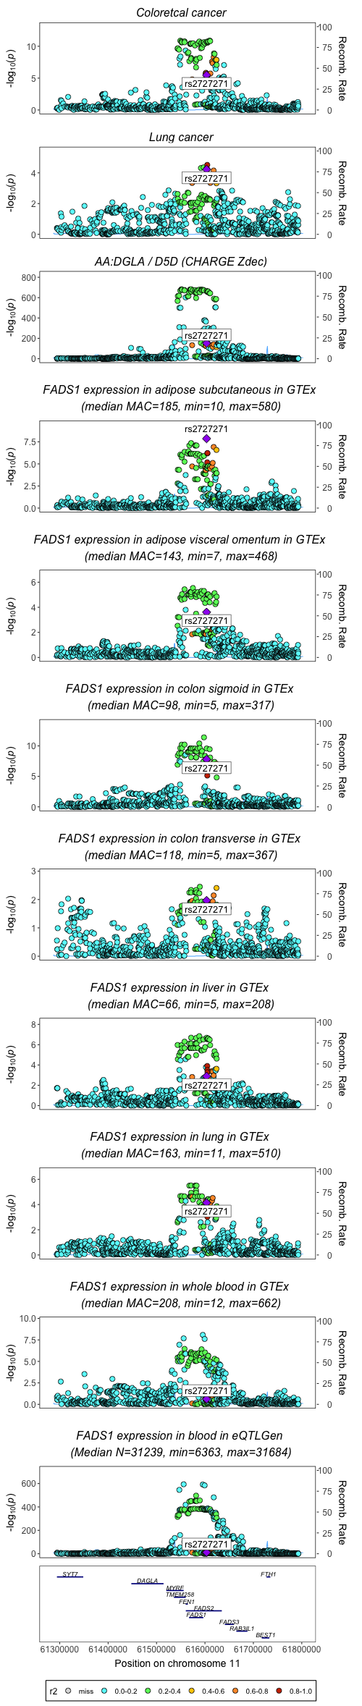

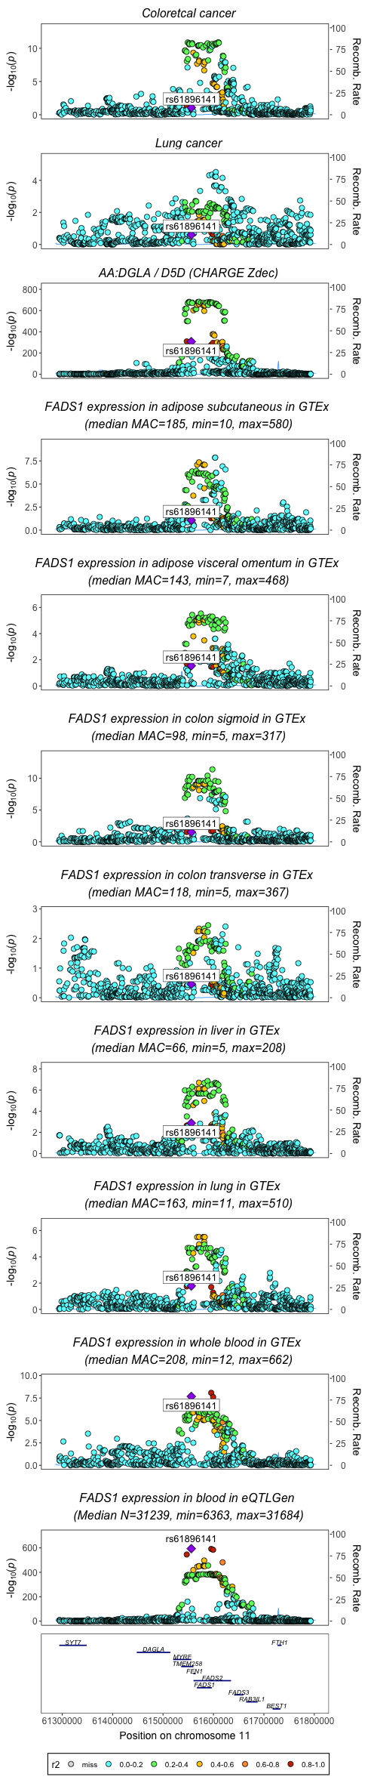
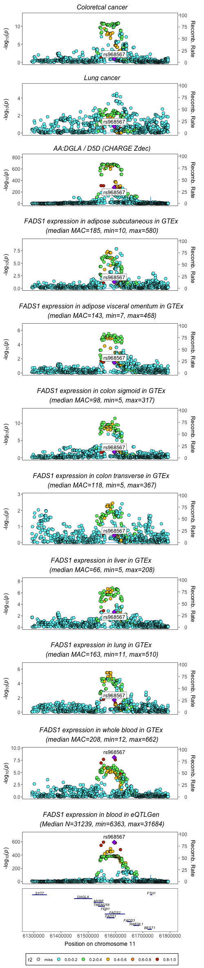
Position of rs174546, rs2524299, rs968567 in associations for FADS1 activity/expression and cancer (imputed dataset for fatty acids from CHARGE)
R2=0.929 rs2524299 and rs2727271
R2= 0.981 rs968567 and rs61896141

Slide 3
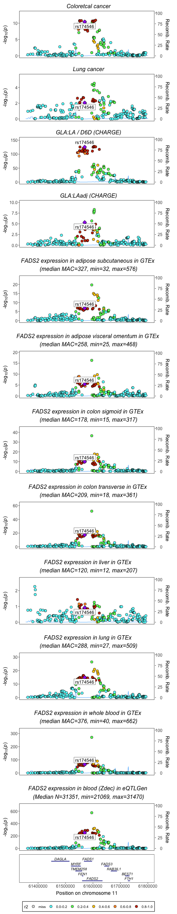
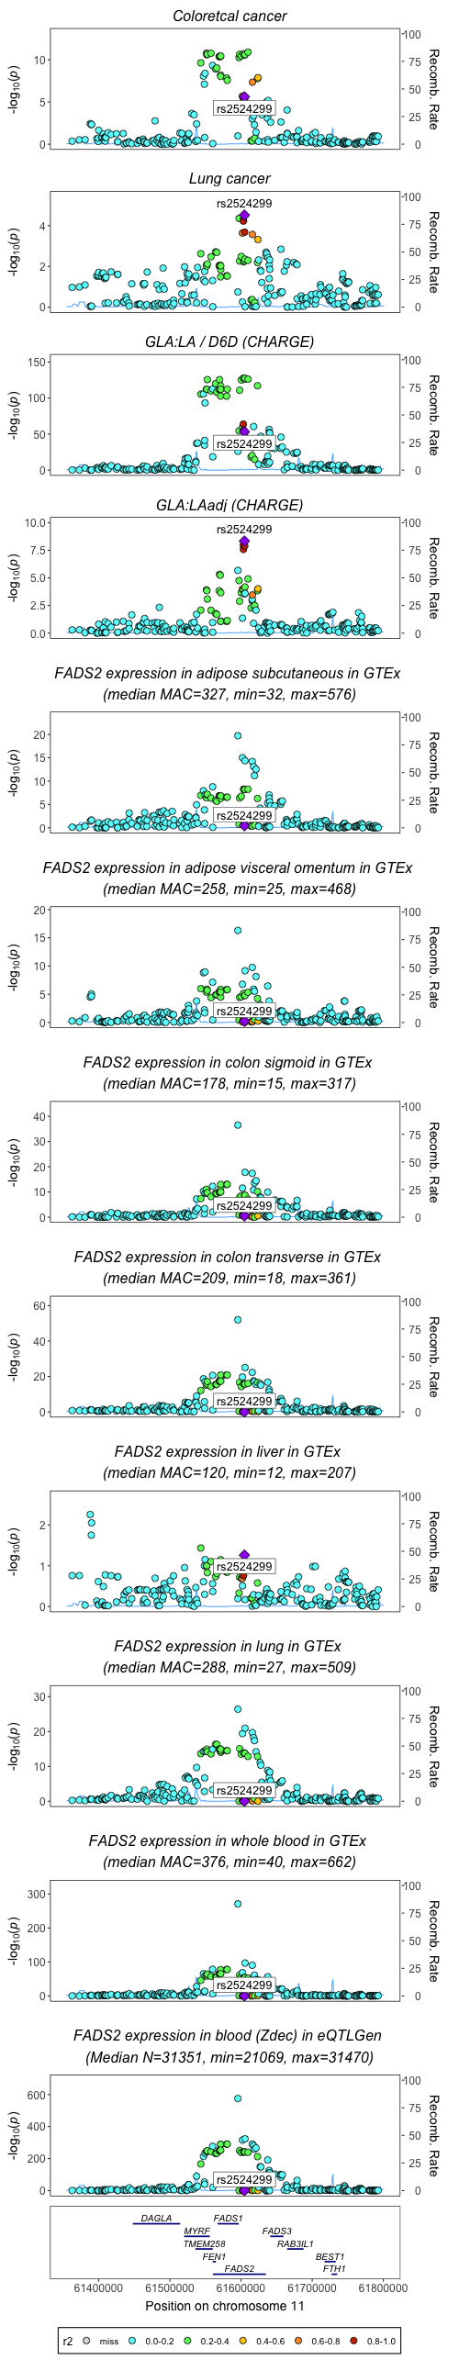
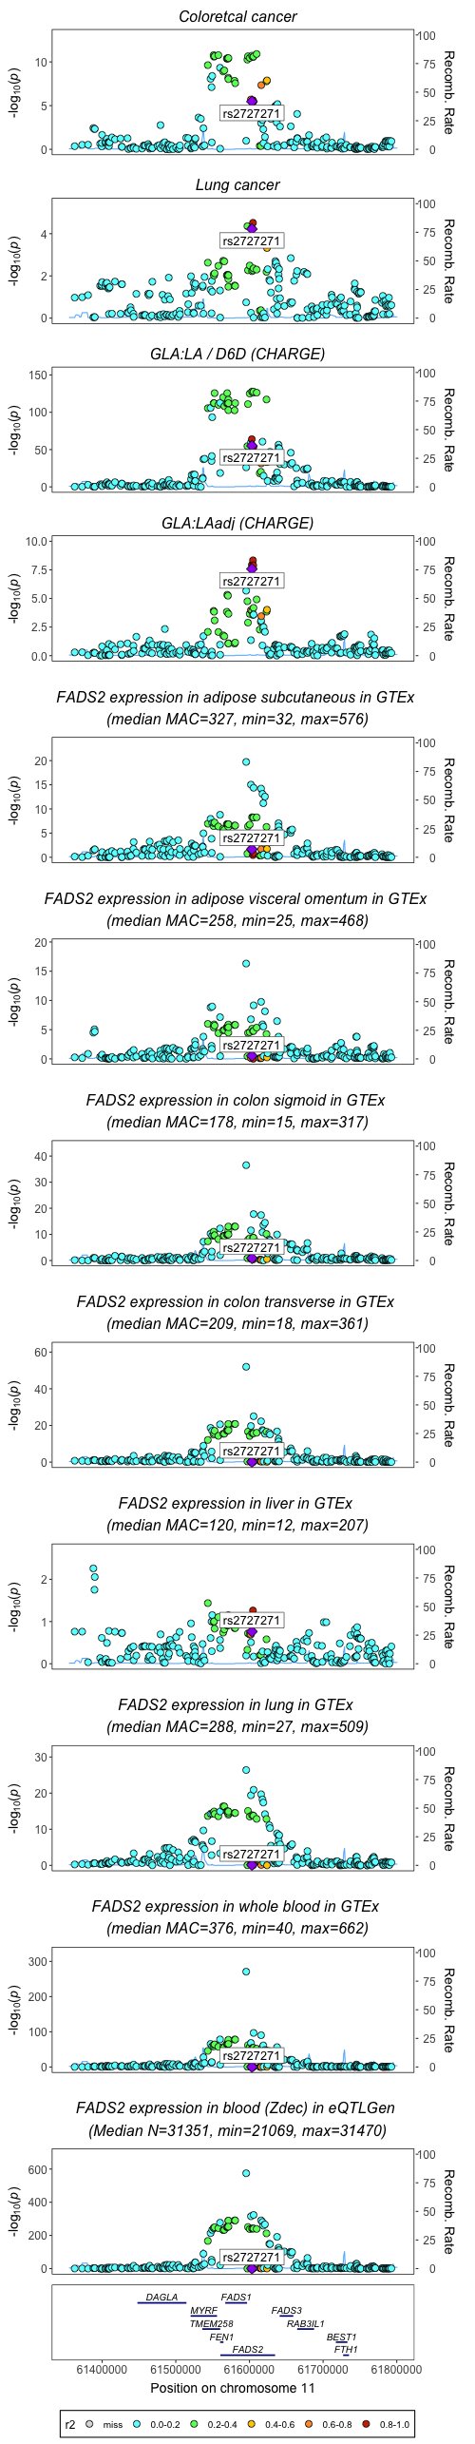
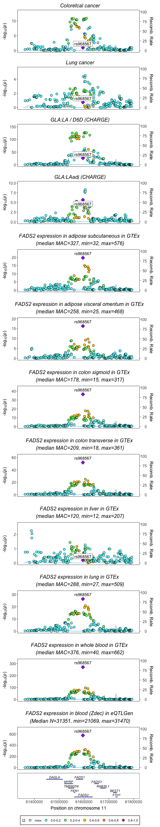
Position of rs174546, rs2524299, rs968567 in associations for FADS2 activity/expression and cancer (non imputed data for fatty acids from CHARGE)
R2=0.929 rs2524299 and rs2727271

Slide 4
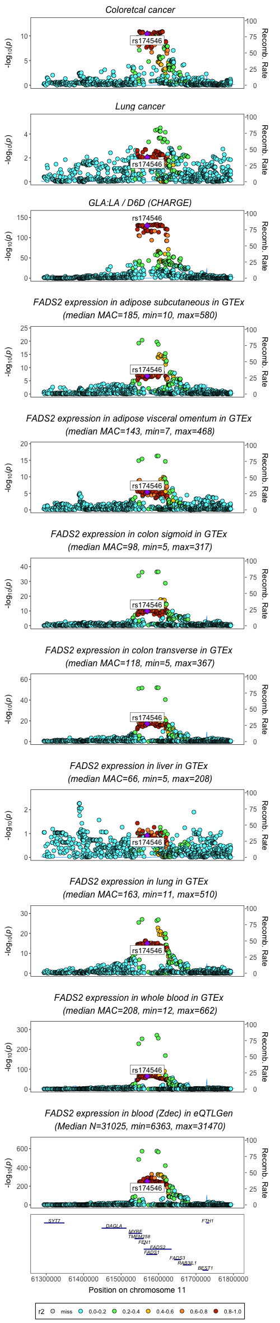
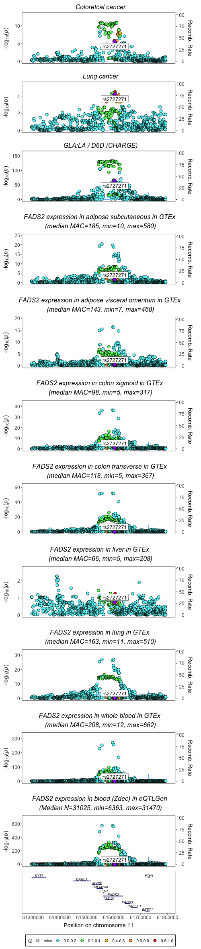
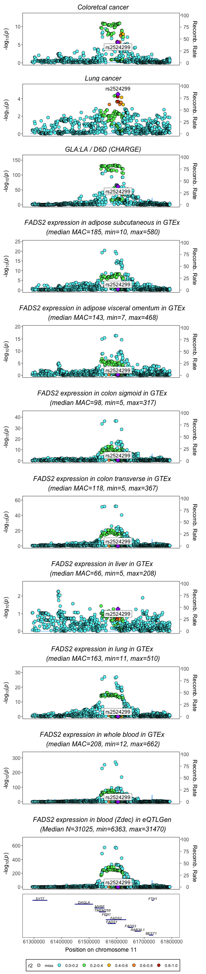
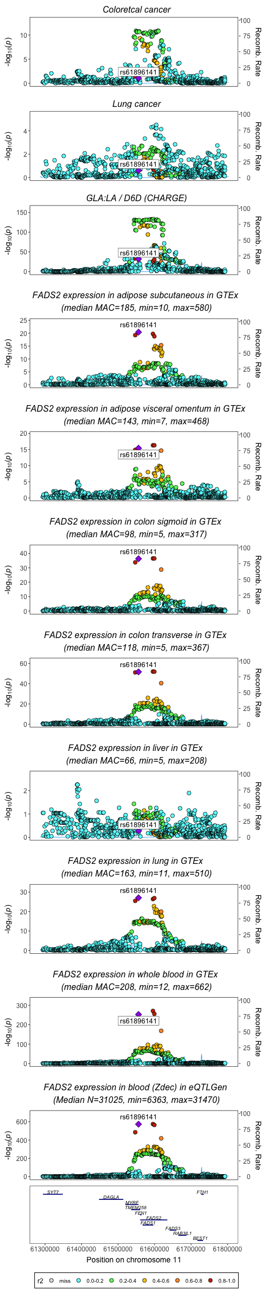
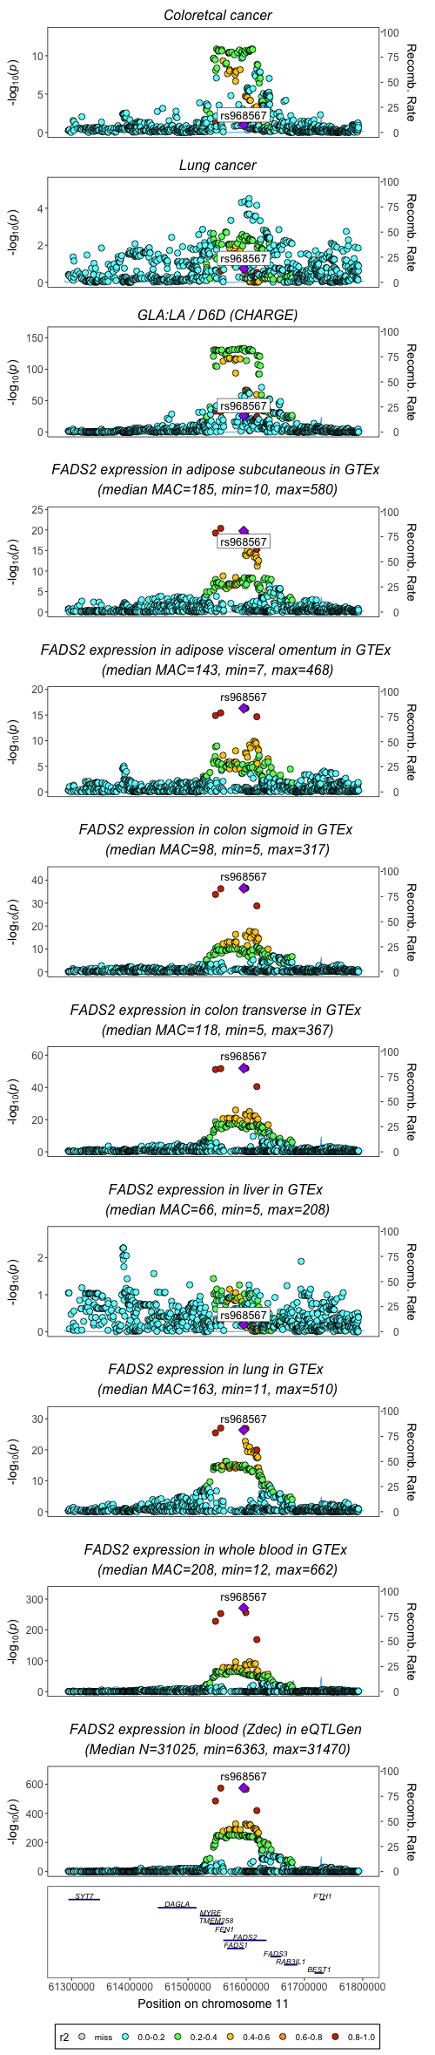
Position of rs174546, rs2524299, rs968567 in associations for FADS2 activity/expression and cancer (imputed dataset for fatty acids from CHARGE)
R2=0.929 rs2524299 and rs2727271
R2= 0.981 rs968567 and rs61896141

